Slide 1
Project 12: Cost-Sensitive Boosting for Classification of Imbalanced Data
Arab Oghli, Omar || Kanafani Hussain || Mughrabi, Muaid
Mentor: Prof. Dr. Eirini Ntoutsi

Slide 2
Agenda
Data Imbalance Problem
Cost-Sensitive Boosting
Implementation
Experiments
Results

Slide 3
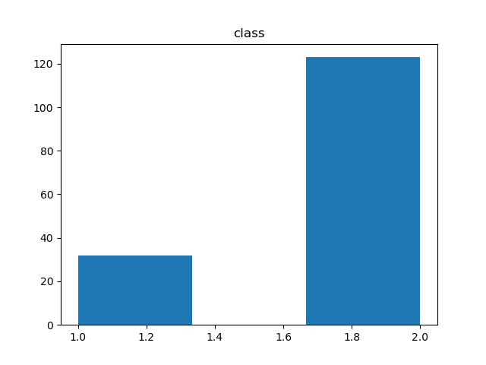
Data Imbalance Problem
Imbalanced class distribution: having many more instances of some classes than others
Conventional Classification Algorithms e.g. decision tree fails!
Standard classifiers are designed to generalize from balanced
training data
Traditional evaluation measures like accuracy are misleading
as they focus on average performance
Imbalanced Distribution

Slide 4
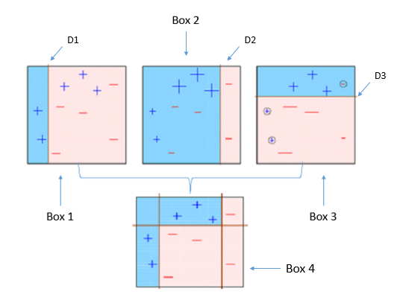

Boosting
AdaBoost: Sequential ensemble algorithm based on n weighted weak learners
Weighting Strategy:
Better Idea: assign class weights!
https://towardsdatascience.com/understanding-adaboost-2f94f22d5bfe

Slide 5
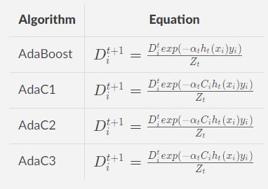
Cost-Sensitive Boosting
Improvement idea: Assign costs to classes (high for the minority) to take the class-membership into account.

Slide 6
Datasets
4 Datasets (used in the paper)
Breast cancer data (Cancer) 9 features 286 instances 29.7% positive, 70.3% negative | Hepatitis data (Hepatitis) 10 features 155 instances 20.65% positive, 79.35% negative
Pima Indian’s diabetes database (Pima) 8 features 768 instances 34.8% positive, 65.2% negative | Sick-euthyroid data (Sick) 25 features 3163 instances 9.26% positive, 90.74% negative

Slide 7
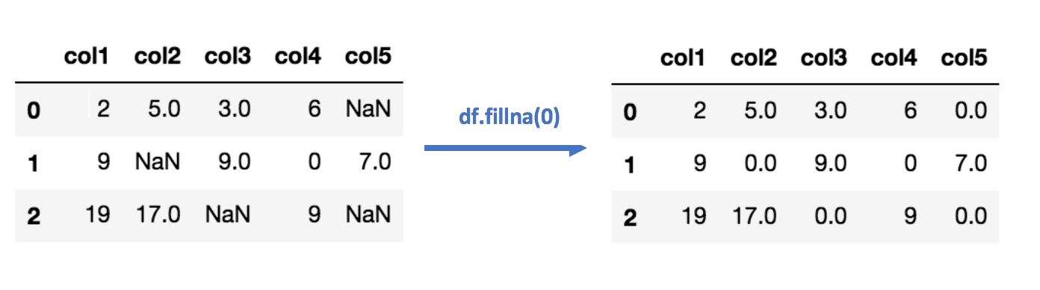
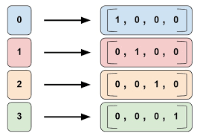
Data Processing
Dealing with missing values
Data Imputation
Categorical features:
One-Hot Encoding
Control imbalance ratio
https://towardsdatascience.com/6-different-ways-to-compensate-for-missing-values-data-imputation-with-examples-6022d9ca0779
https://cran.r-project.org/web/packages/tfdatasets/vignettes/feature_columns.html

Slide 8
Implementation
ML Pipeline:
Data Preprocessing
Model Training
Evaluation

Slide 9
Experiments
Test sets construction:
80% 20% 10-fold random construction
Different class costs:
Minority class always 1
Majority class from 0.1 to 0.9
Weak learners: 10 Decision-Tree classifiers

Slide 10
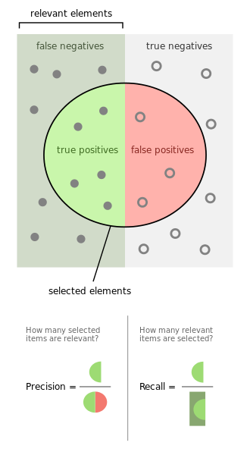

Evaluation Measures
Evaluating the predictive performance:
Precision
Recall
F-Measure
https://en.wikipedia.org/wiki/File:Precisionrecall.svg

Slide 11
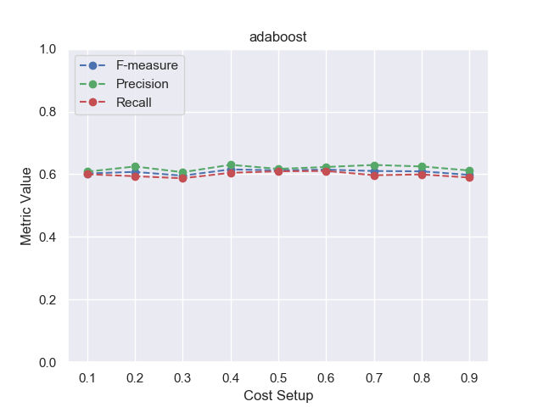
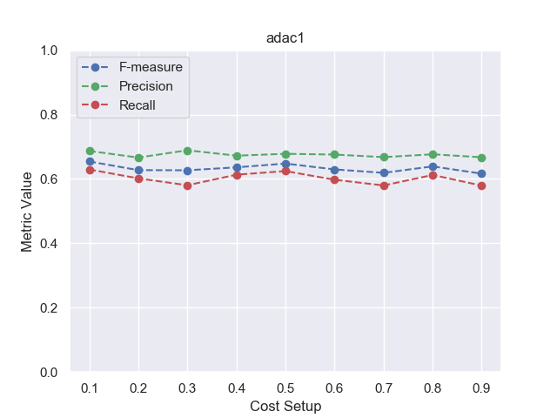
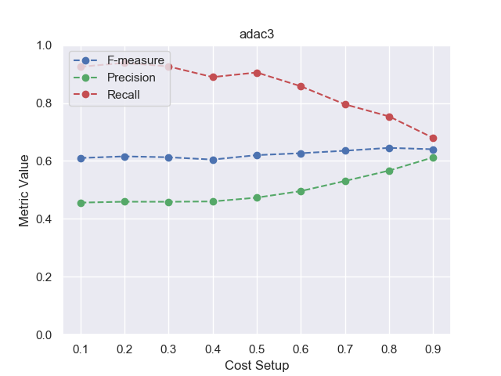
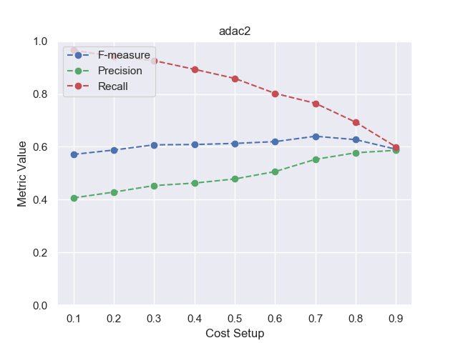
Results

Slide 12
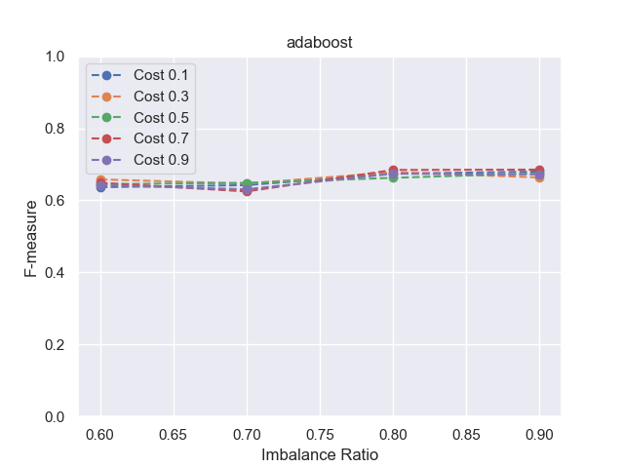
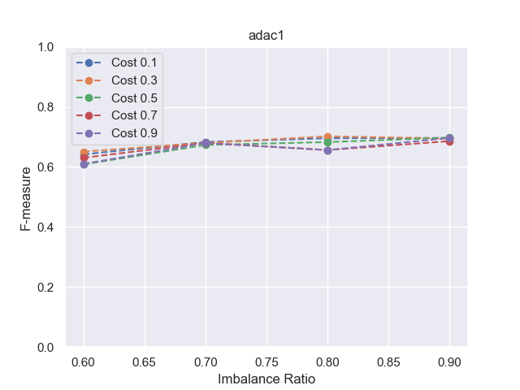
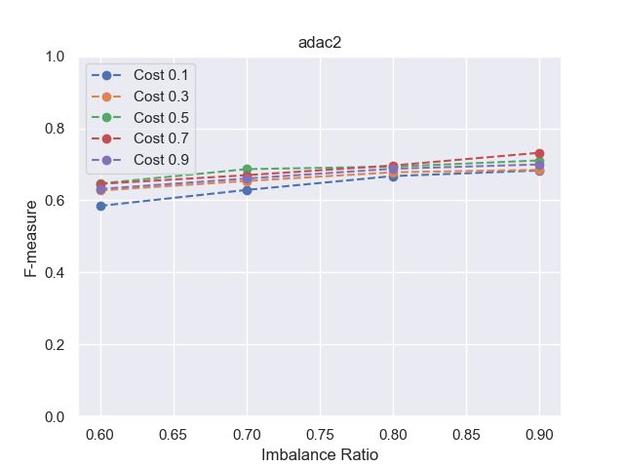
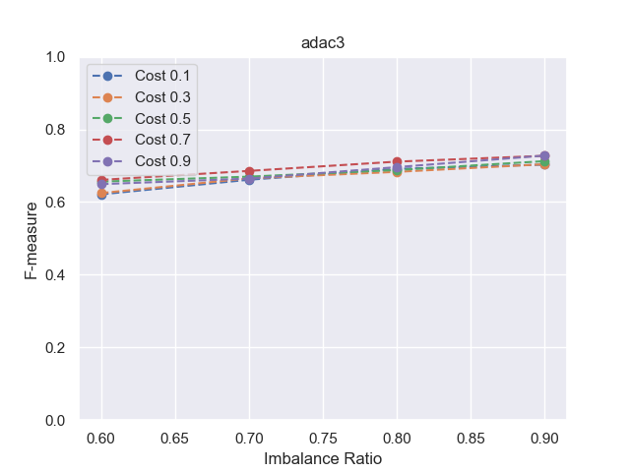
Results
Imbalance ratio = #minority / #majority

Slide 13
Questions?

Slide 14
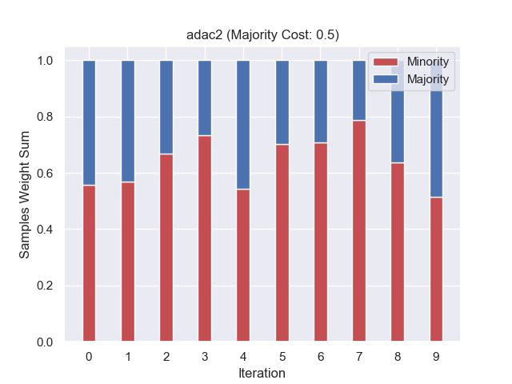
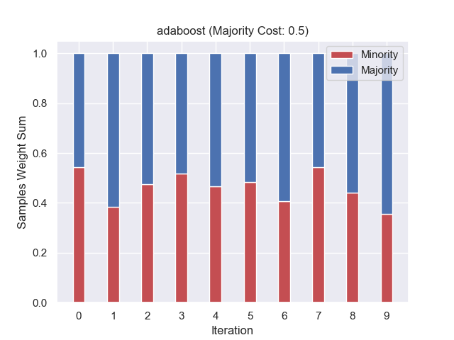
Algorithmic Behavior

